Slide 1
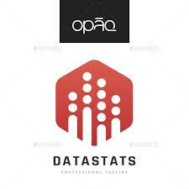

Twitter Sentiment Analysis
By- Krishna Pal Deora

Slide 2
Sentiment analysis (also known as opinion
mining) refers to the use of natural language
processing, text analysis and computational
linguistics to identify and extract subjective
information in source materials.
Consumers can use sentiment analysis to
research products and services before a
purchase. Production companies can use the
public opinion to determine acceptance of their
products and the public demand. Movie-goers
can decide whether to watch a movie or not
after going through other people’s reviews.

Slide 3
Twitter Sentiment Analysis
 Traditionally, most of the research in sentiment analysis
has been aimed at larger pieces of text, like movie reviews,
or product reviews. Tweets are more casual and are limited
by 140 characters.
 However, this alone does not make it an easy task (in
terms of programming time, not in accuracy as larger piece
of text tends to be correctly classified) as people rarely
give a second thought before posting a tweet. Grammar
and content both suffer at the hands of the tweeter.
 The presence of a large dataset is always recommended
(for better training of the classifier) and twitter makes it
possible to obtain any number of tweets during a desired
period. However, various difficulties are faced during
processing of raw tweets.

Slide 4
Previous work
Alec Go, Richa Bhayani and Lei Huang (Students at
Stanford University) have done some serious work in
twitter sentiment analysis.
Even though their source code is not publicly available,
their approach was to use machine learning algorithm
for building a classifier, namely Maximum Entropy
Classifier.
The use of a large dataset too helped them to obtain a
high accuracy in their classification of tweets’
sentiments. The data set used by them is however
public and I too have used the same data set in order to
obtain results as close to theirs as possible. Other
noteworthy works are by Laurent Luce and Niek
Sanders. Both of them used quite smaller datasets, but
their work consisted of some insightful approaches.

Slide 5
Challenges
Usernames are mentioned more often than not. Usually
they consist of some alphabets and numbers, and do not
contribute much towards sentiment classification, except
for increasing the size of the feature vector.
 URLS too are not required in our task.
 Hashtags Words in hashtags may be read different from
the same word without the hash tag
 Punctuations and additional spaces.

Slide 6
Raw dataset of 3000 tweets
Using 3 different hashtags
#Corona
#BJP
#Congress

Slide 7
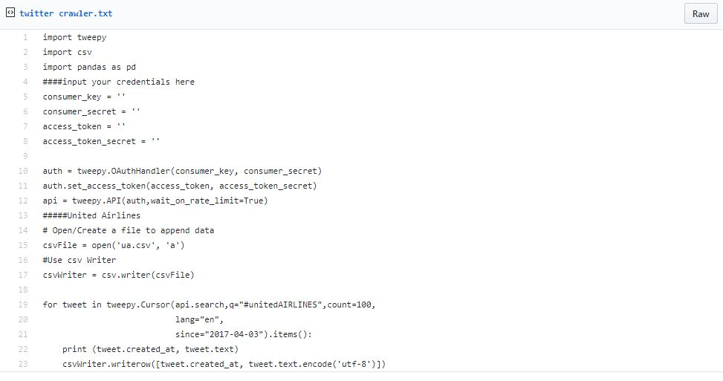

Slide 8
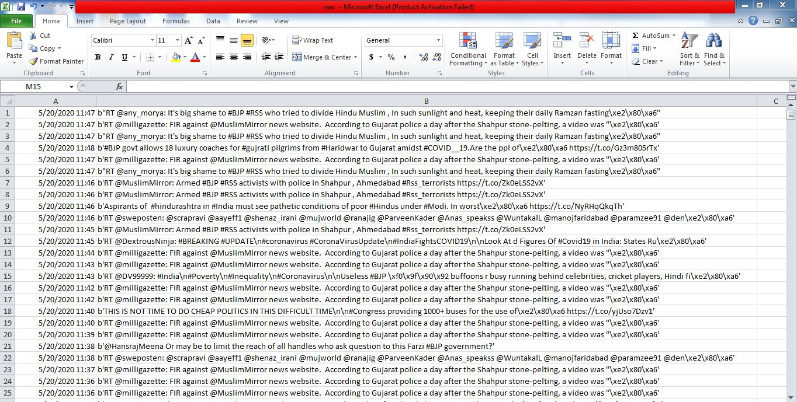

Slide 9
Preprocessing of tweets
 All tweets were converted to lower case
 All links and urls were removed
 All usernames were placed in separate column
 Words with hashtags were replaced with the same words without the hashtag
 Punctuations and additional white spaces were
removed from the tweets.
 All the above work was done in python.

Slide 10
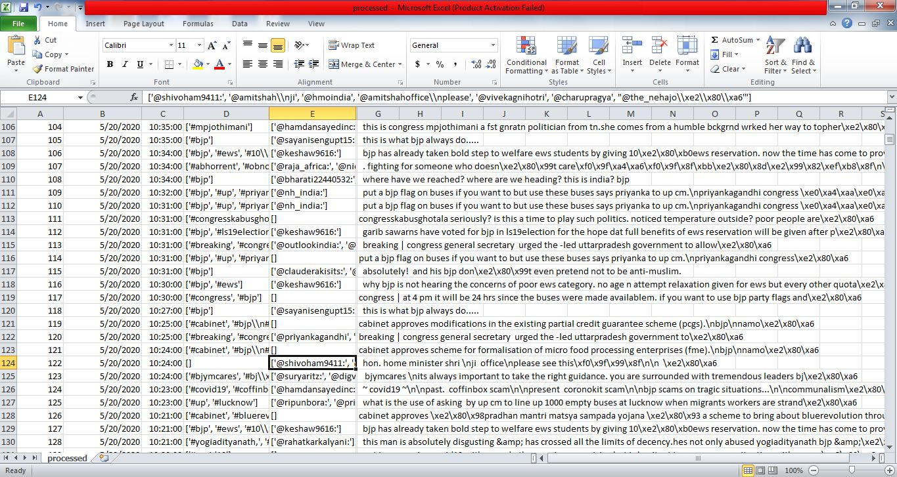

Slide 11
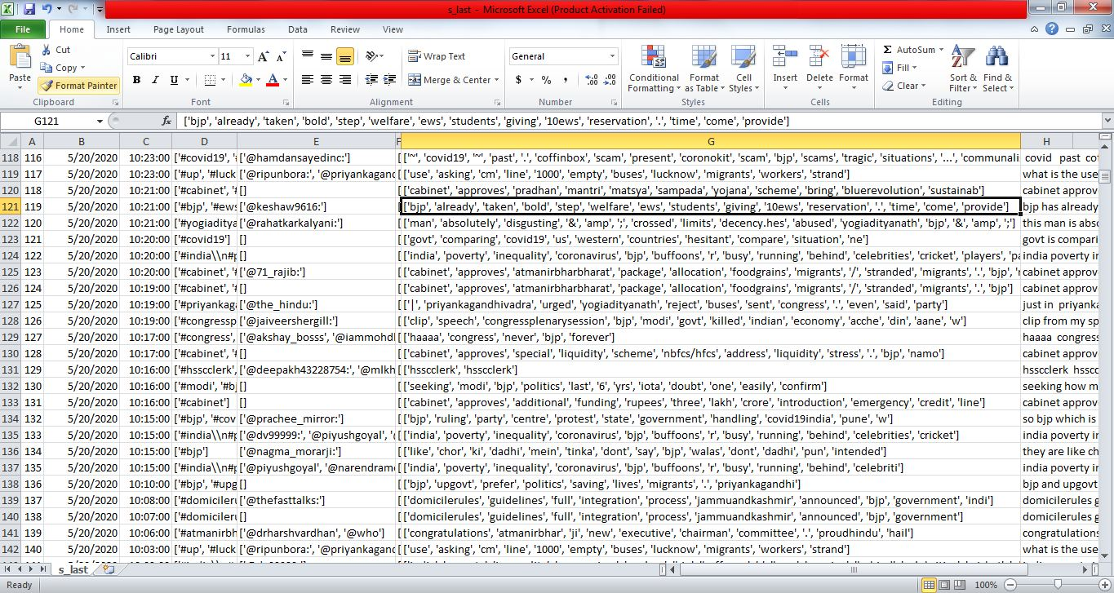

Slide 12


Training dataset
Dataset used in this project is publicly
available and can be found at:
http://cs.stanford.edu/people/alecmgo/training
andtestdata.zip
It consists of 80,000 positive and 80,000
negatively classified tweets based on the
emoticons used by the user.
:- ) : ) :D =) were used to mark tweets
with positive sentiment.
:- ( : ( were used to
mark tweets with negative sentiment.

Slide 13
Approach
Filtering for Feature Vector:
1.) Stop words such as a, an, is, the, you,
she, he, it, they etc are removed as they do not
indicate any sentiment.
2.) Words starting with anything but
alphabets were removed for simplicity sake.
3.) Punctuation and repeating words were
removed as they do not serve any purpose.

Slide 14
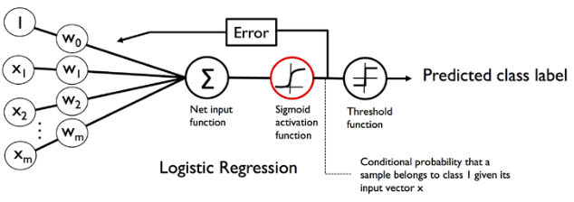
Logistic Regression
Logistic Regression is a classification model that is very easy to implement and performs very well on linearly separable classes. It is one of the most widely used algorithms for classification in industry too, which makes it attractive to play with.
Very simplistically explained, Logistic Regression works as follows:

Slide 15
Support Vector Machines
 A support vector machine constructs
a hyperplane or set of hyperplanes in a high- or
infinite-dimensional space, which can be used for
classification, regression, or other tasks.
 Intuitively, a good separation is achieved by the
hyperplane that has the largest distance to the
nearest training data point of any class (so-called
functional margin), since in general the larger the
margin the lower the generalization error of the
classifier.

Slide 16
Random Forest
Random Forest is another supervised machine learning algorithm which can be used for classification as well as regression. This algorithm creates a forest with n number of trees which we can pass as a parameter. Random Forest is a step further to the Decision Tree algorithm. A decision tree is a very popular supervised machine learning algorithm which works well with classification as well as regression.
It starts from a root node and ends at a leaf node (decision) by carefully splitting into branches based on conditions (decision node) and moving forward till a final decision is reached. The splits happen based on the decision node which provides the largest information gain or decreases the entropy.

Slide 17
Results
Using unigrams as features,
Accuracy of:
Naïve Bayes Classifier –
Support Vector Machines –
Random Forest –

Slide 18
Conclusion
 Even though unigram feature extractor
is the simplest, it fails to identify
negations. Using bigrams will help a lot
in increasing the accuracy of the
classifier
 Presence of neutral tweets too causes a
dip in the accuracy

